Slide 1
Proposed by TIEZ:
LI FANGBO 李放波
WANG YI 王懿
ZHENG YANG 郑洋

Slide 2
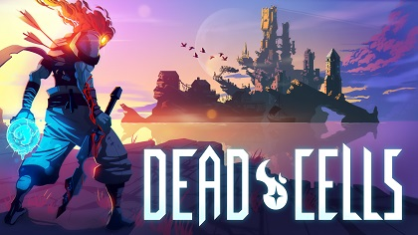
Purpose
We want to build a 2D Rogue-like game that provides a feeling of achievement through collecting, challenging and exploring that switches between relaxing and intense mode.
Explorer
Challenger
Collector

Slide 3
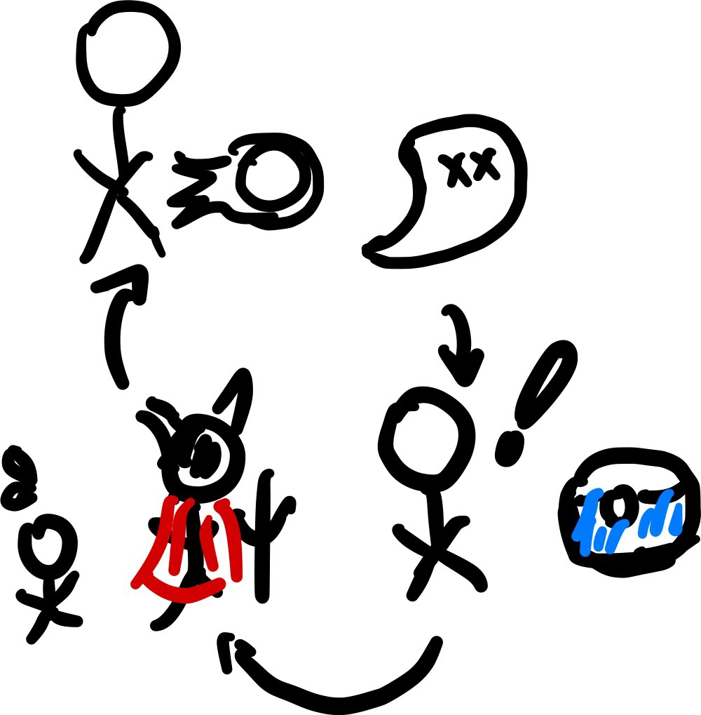
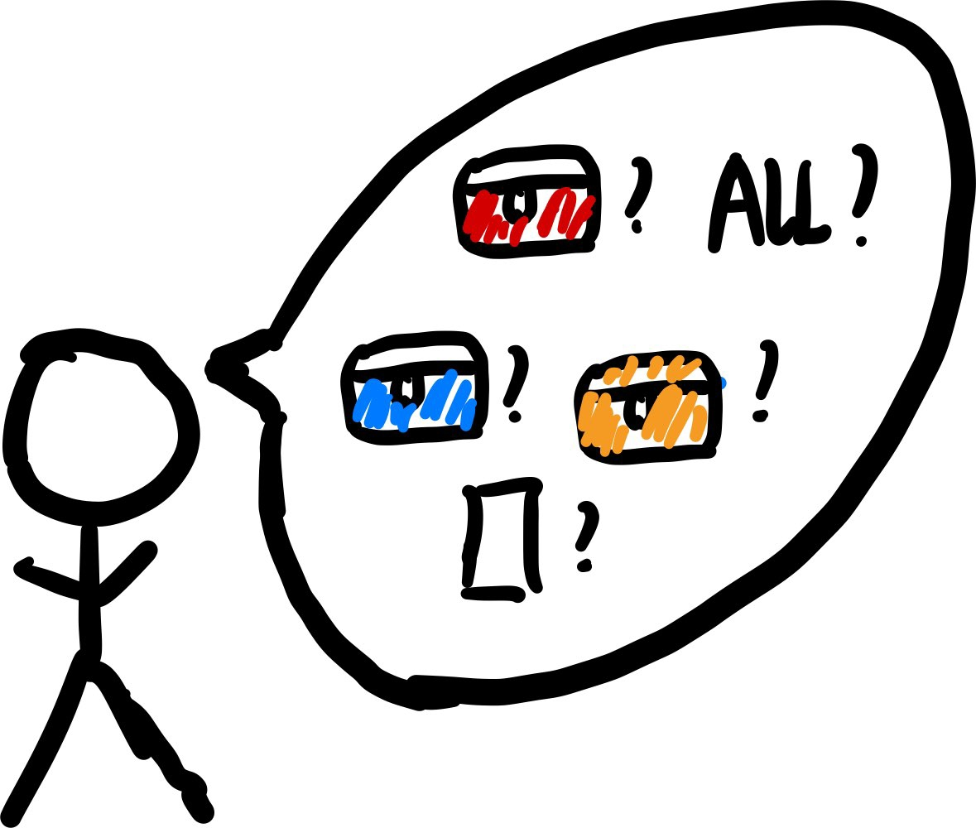
Achievement
Challenger
Collector
Explorer

Slide 4
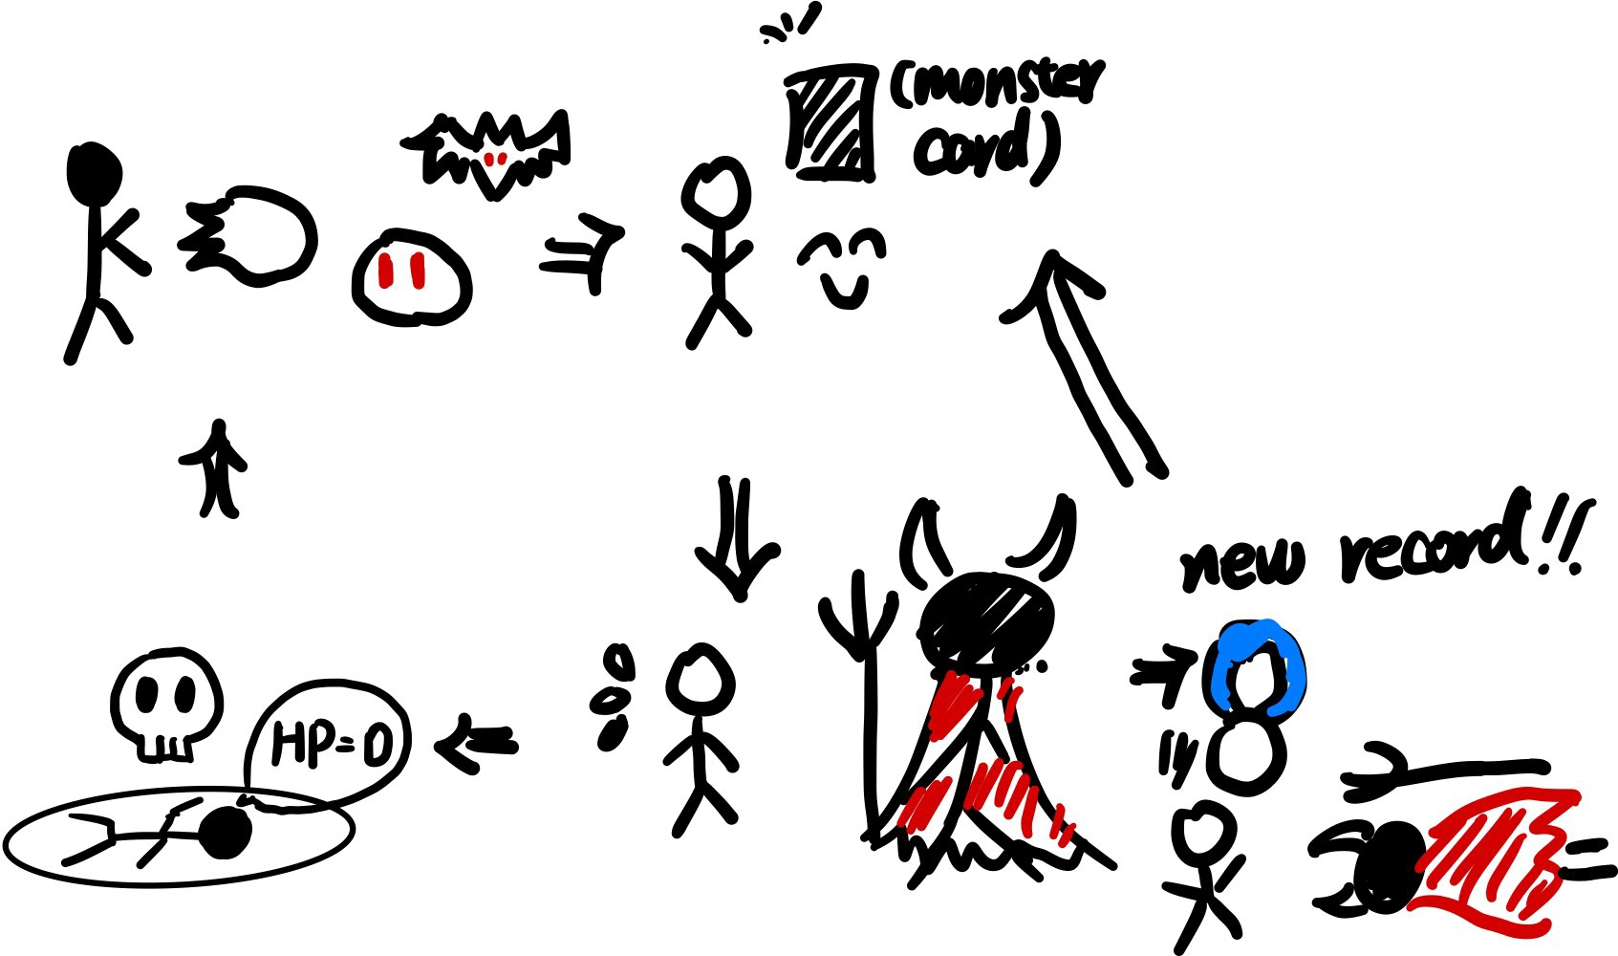
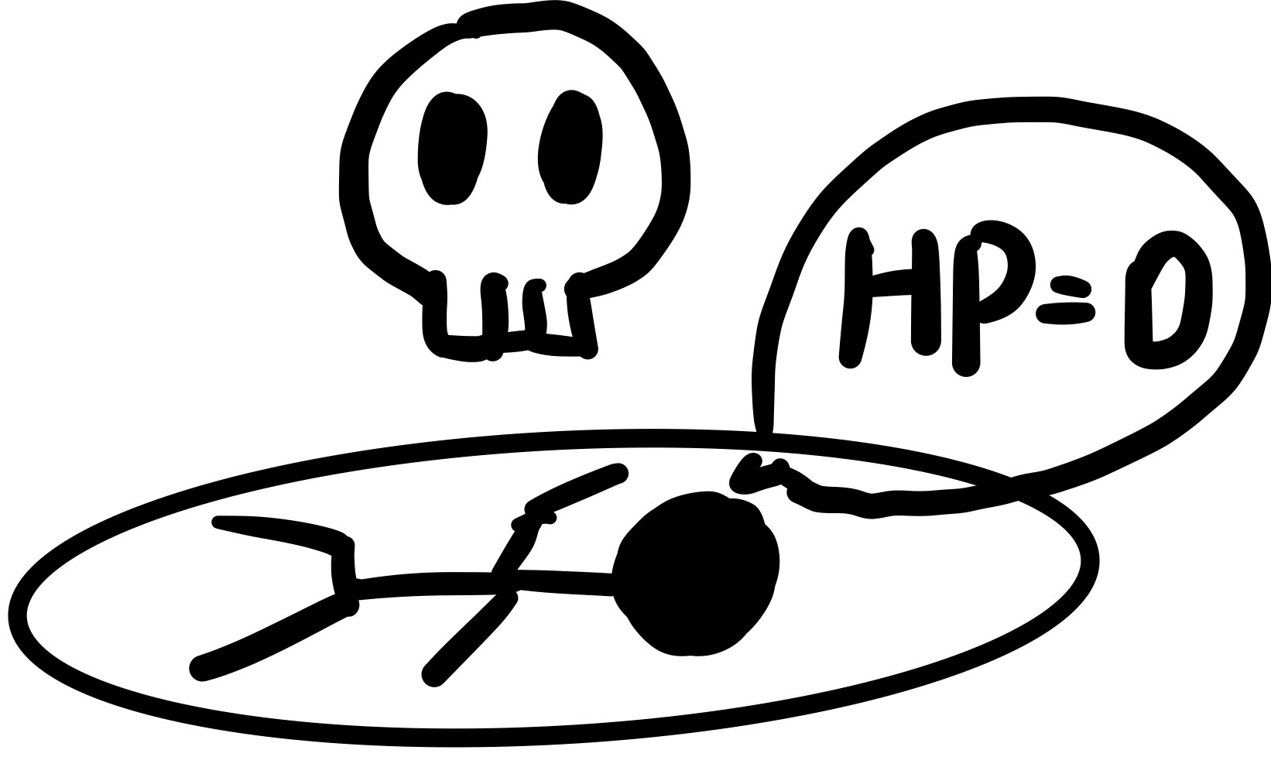
Win/Lose Condition
When the HeartPoint of the main character falls to zero, the main character “dies”.
However, the game has not a specific win condition, because it works as a loop. The reward players can get are different which will be later explained. At the picture, it’s challenging the Boss.
Lose

Slide 5
Achievement
Specific Designed Logistics for Boss
Beat the Challenging Boss as Fast as Possible
Record of the Time the Player to Beat the Boss
Restrict
-ed Source
Honor for Particular Accomplishments
Attack Mechanism
Challenger

Slide 6
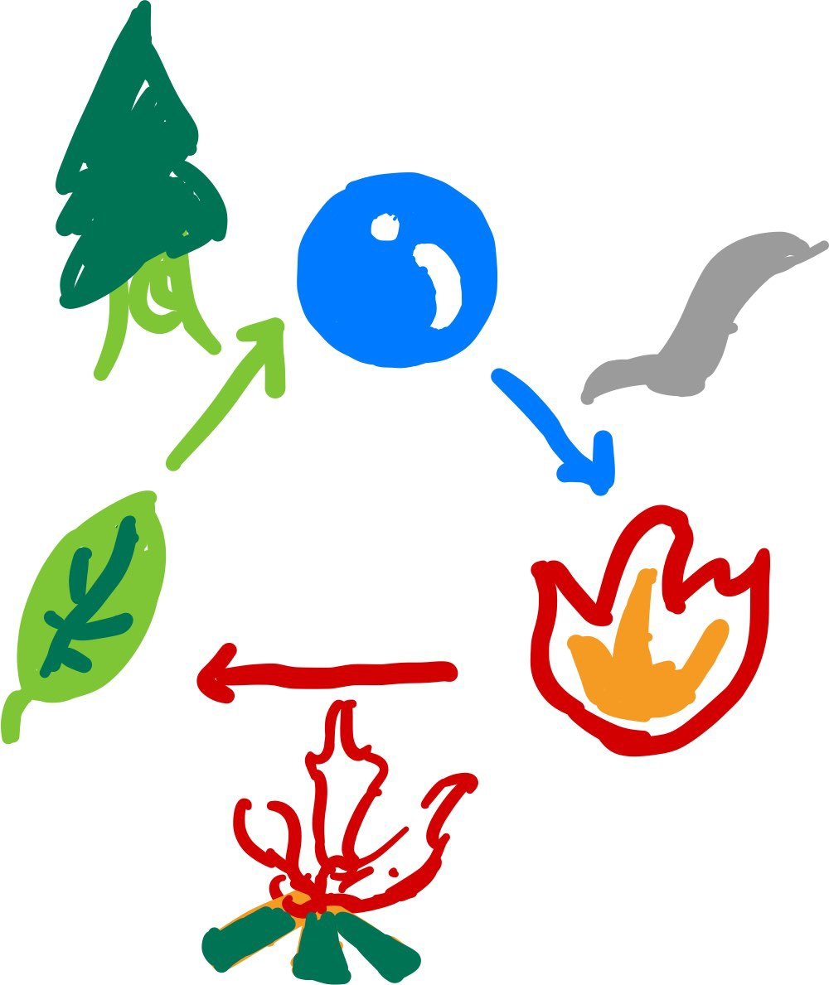
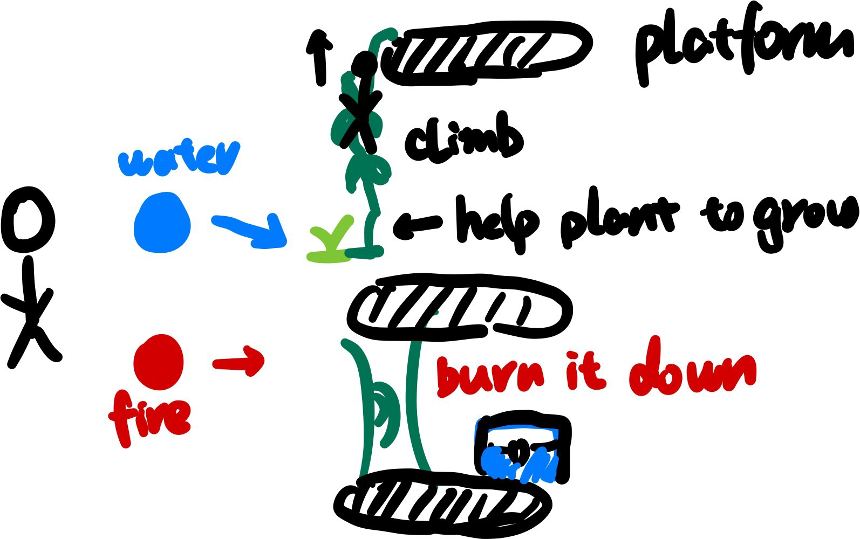
Achievement
Collector All the Monster Cards
Monster Card
Find Out All the Combination of Elements
Element Reaction
Collector
Search Every Corner of the Map
Puzzle

Slide 7
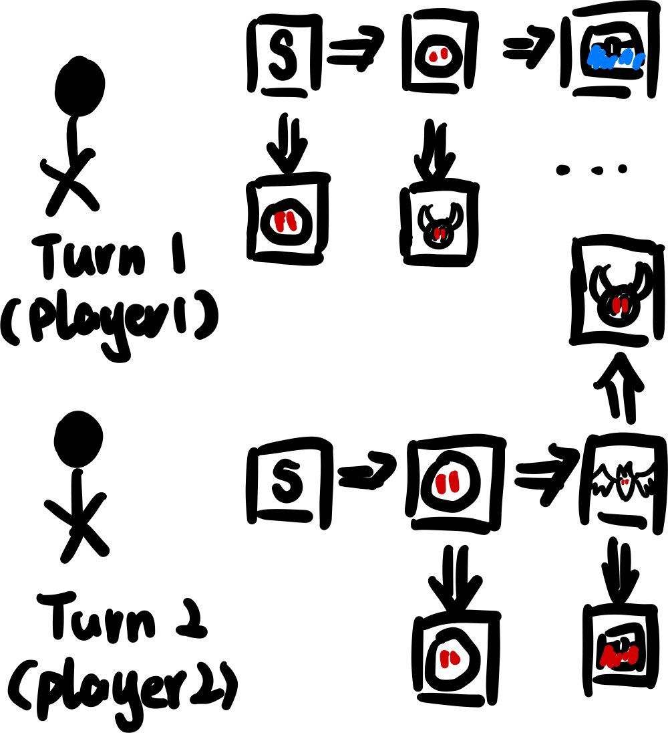
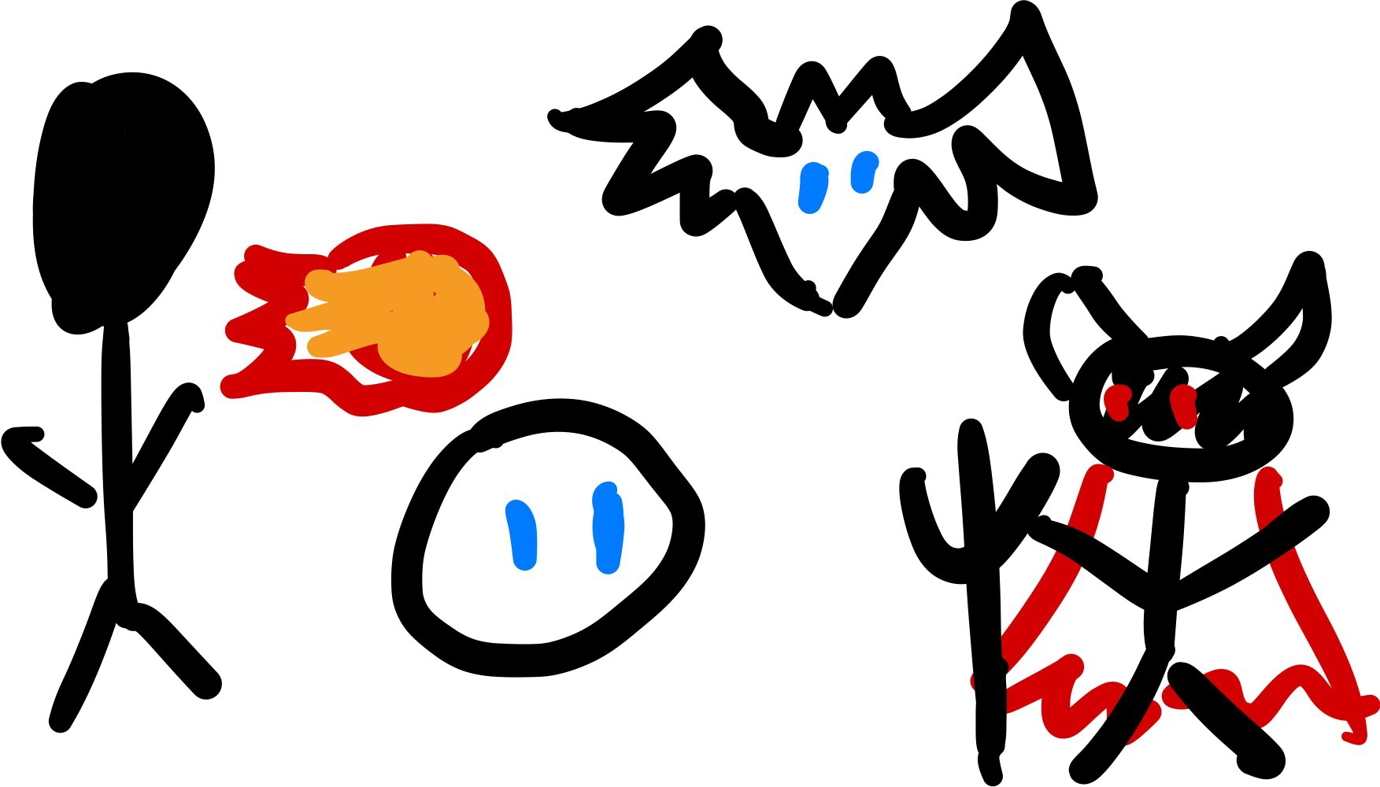
Achievement
Try Refreshing Things of Game
Dynamic Map
Complete The Game in an easy way
Summon System
Explorer

Slide 8
Upgrade
Attack
Beat the Challenging Boss as Fast as Possible
Specific Designed Logistics for Boss
Element
...
...
Puzzle
Levelup
Complete The Game in an easy way
Summon System
Goal
Feature
System

Slide 9
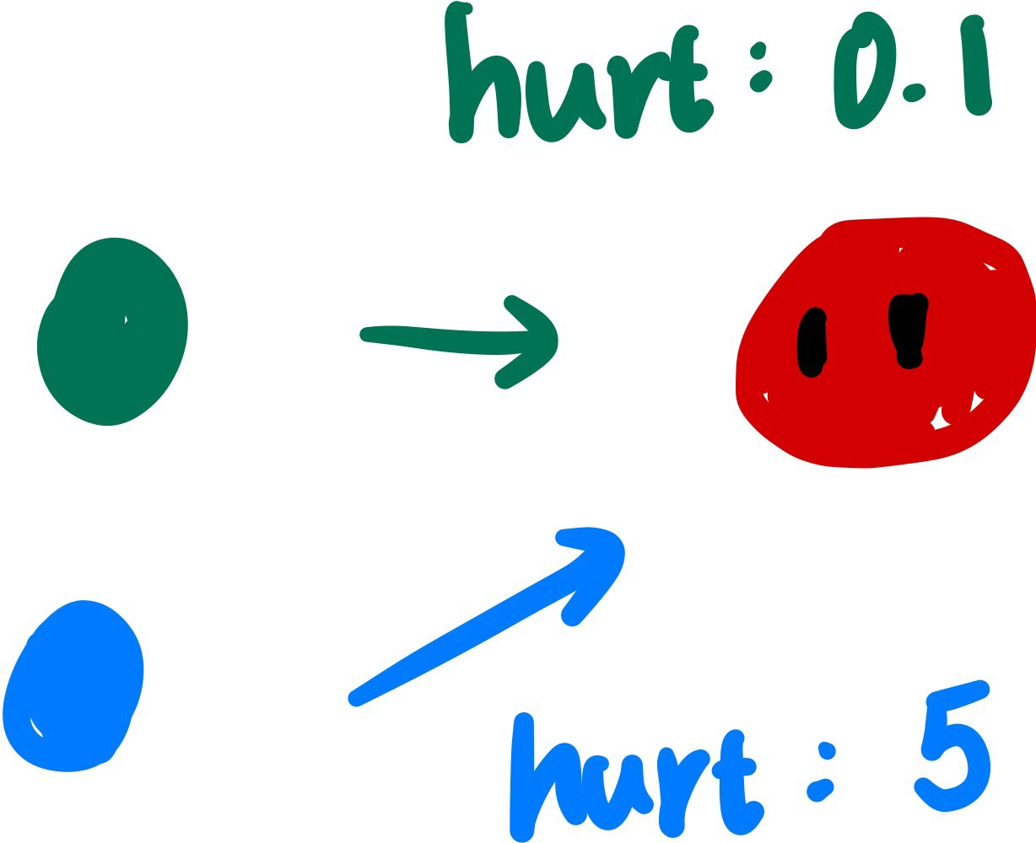
Upgrade
Attack
Element
Puzzle

Slide 10
Originality
card collection, beckon, element interaction

Slide 11
Inspiration
魔法元素, 游戏王, 冒险岛, 死亡细胞, noita, 龙与地下城, dragon quest

Slide 12
Attraction
reasons that you play
refreshing combination of element interaction mechanism and monster collecting and summoning mechanism
reasons that you play again
break your record
gain honorary title for particular accomplishments
different map and experience every time

