Slide 1
Spacecat
Team 7
黄雅雯(Huang YAWEN)
刘缺(Liu Que)
张格格(zhang gege)
唐从容(tang congrong)

Slide 2
outline
backgrounds
UI, THEME & sTYLE
Settings
Wishlist

Slide 3
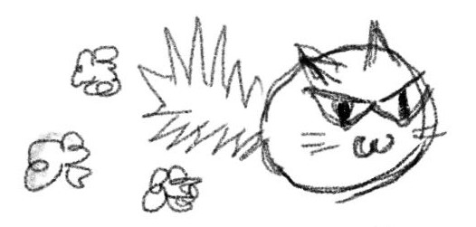
plot
In a distant galaxy, there was a fearless cat named Whiskers. One day, Whiskers stumbled upon a mysterious spaceship hidden deep in the forest. Curiosity piqued, she hopped inside and launched, and soon, she arrived at her first destination: Pizza Planet.
Whiskers need to find one key for leaving each planet and collect as more ores as possible to fuel her spaceship.

Slide 4
Scenes backgrounds
Pizza Planet: the air is full of cheese so the gravity is unstable
Balls-of-yarn Planet: Whiskers may be attracted to any point because the cat can never resist the temptation of yarn
Egg Planet: the land on this planet is made of eggshells so it will be easy to fall at any position

Slide 5
Game experience goals
The player will be able to relax by controlling the non-human acter to forget annoying stuff in human world.
The player will get a sense of fulfillment by collecting and exploring new scenes.

Slide 6
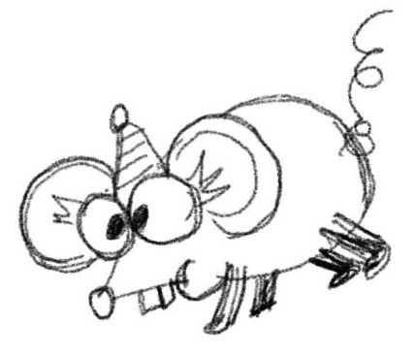
UI, theme & style
Our UI design is based on our story background, with the protagonist being the cute space cat and its enemy: the Rat King.
It uses a unique simple stroke style to make people feel relaxed and happy while playing games.

Slide 7
Our Start Menu
Click the button/ Type "S" to start
Click the button/ Type "Q" to quit

Slide 8
Our Loading Page
The cat and the Rat King will shake their body when the game is loading to game level interface
The cat family will rotate 360 degrees during game loading

Slide 9
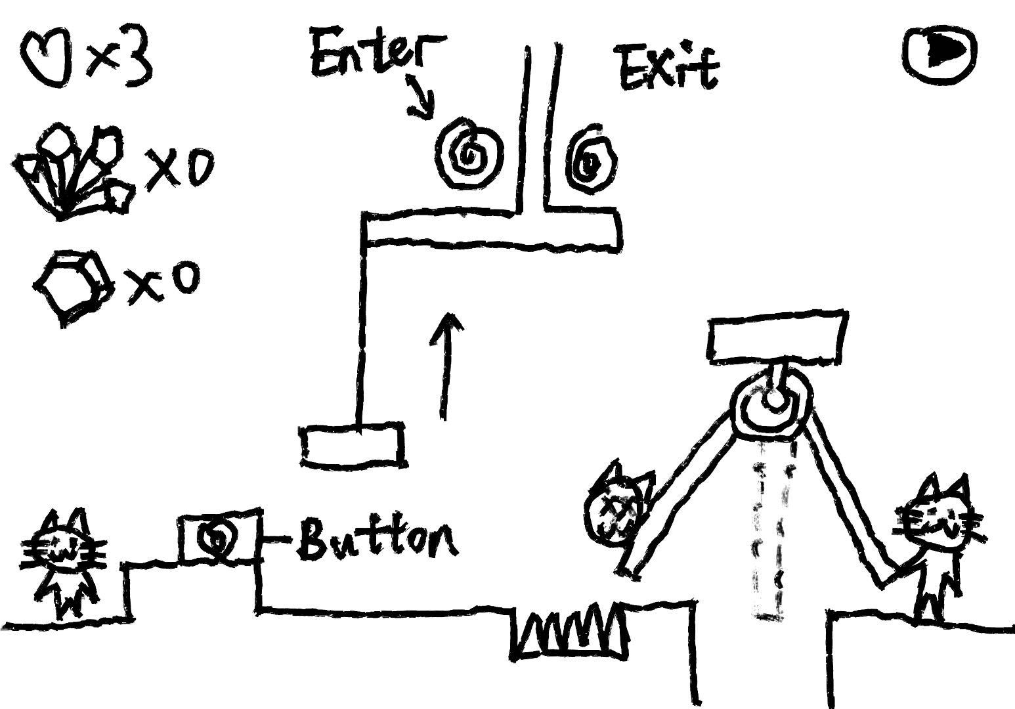
Level Interface

Slide 10
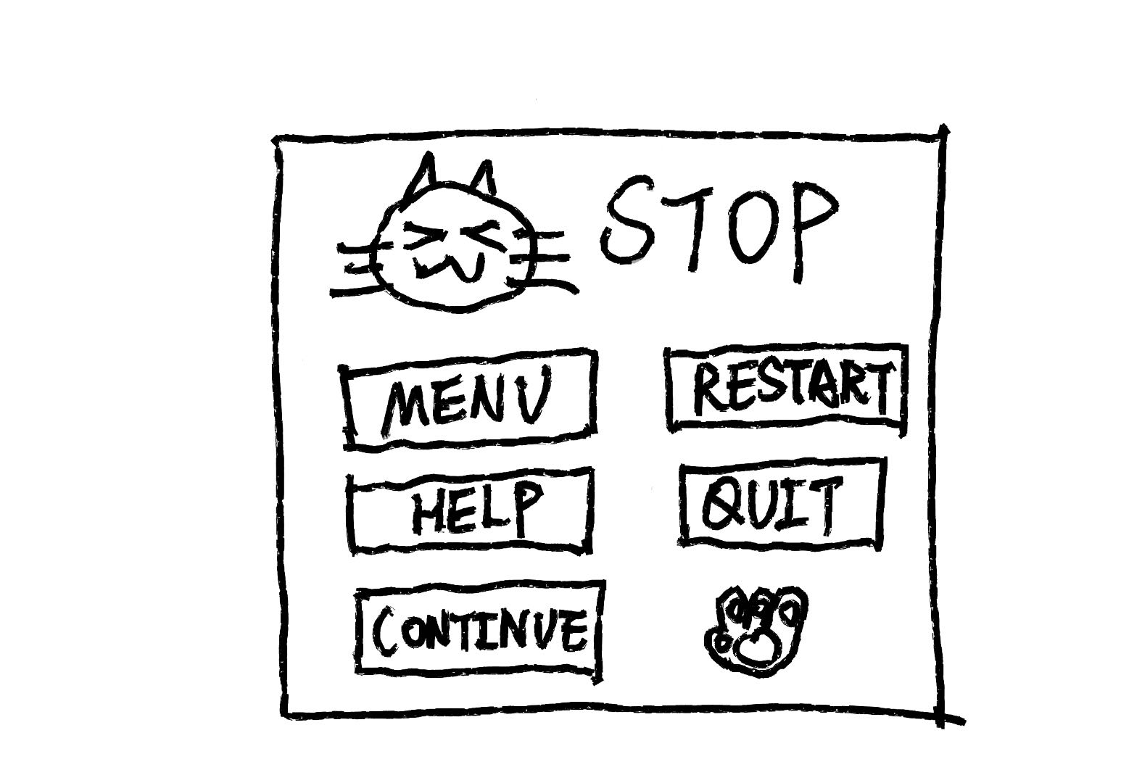
Stop Page

Slide 11
Characters, items & objective
CHARACTERS​
Cat and enemies​
ITEMS​
Characters​
Map settings​
Collections​
'Cute' artworks​
OBJECTIVE​
Explore the planet and collect the resources as much as possible​
Find the way to escape

Slide 12
rules
RULES
The cat hero only have one skill to tranfer a Catball
The Catball could be shoot to attack enemy
When hero touches the trap or touches the enemy in normal mode it will die
Need to find the key first then use key to escape by the end

Slide 13
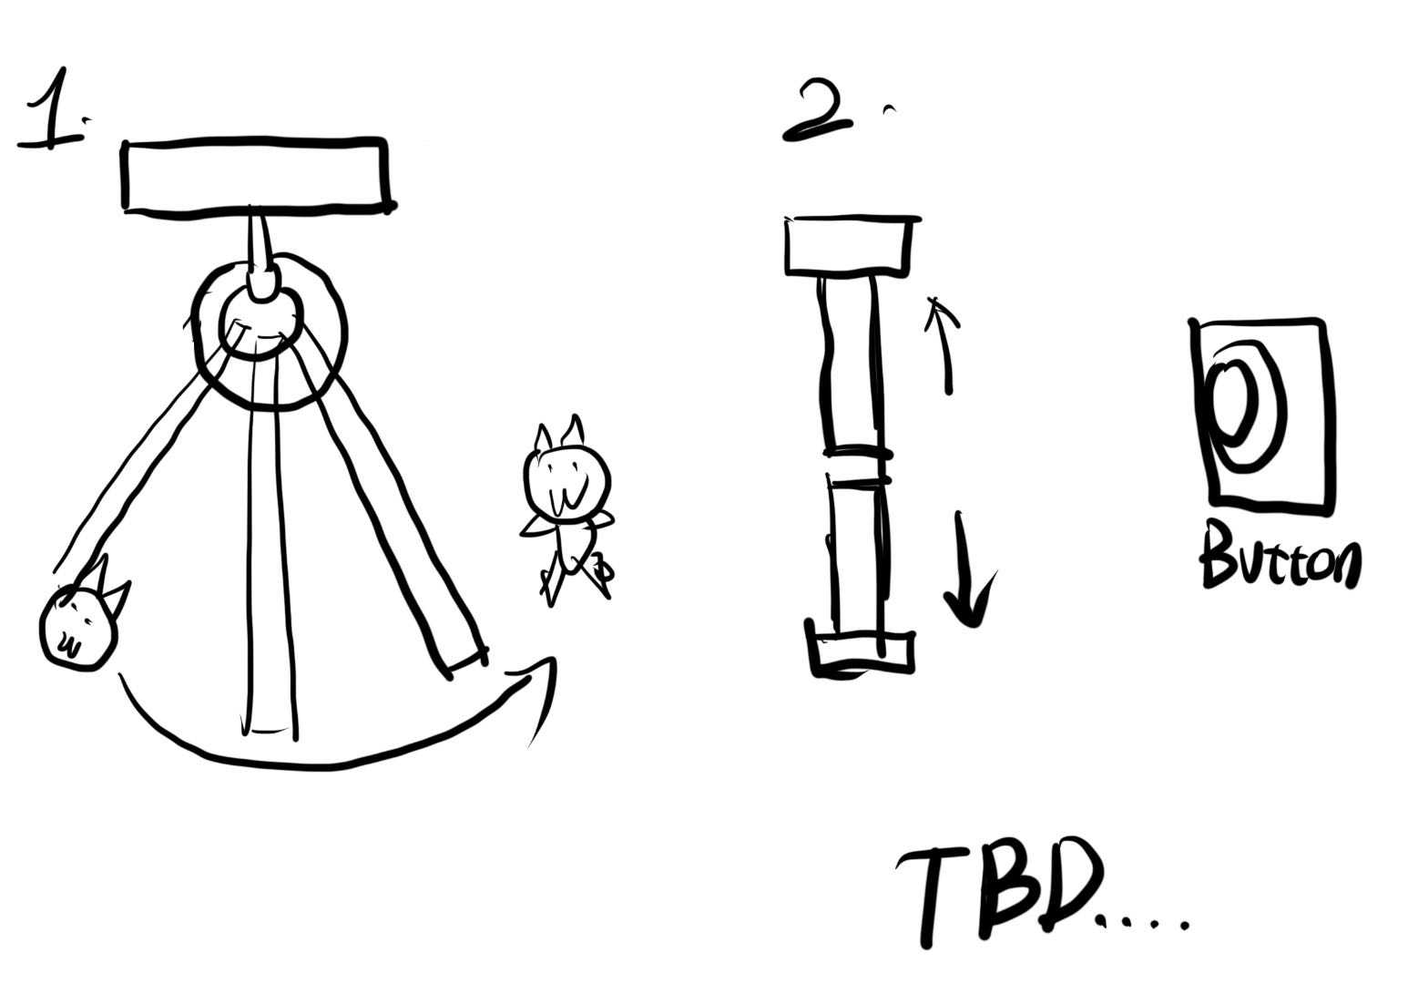
Devices

Slide 14
example

Slide 15
example

Slide 16
Key prototype to test
1.the character(space cat)
2.the traps
3.interface
(from the main interface to the level interface)

Slide 17
Wishlist
1.The ejection can be adjusted
2.More complex levels
3.Add character skills

Slide 18
END
Thank you for watching

