Slide 1
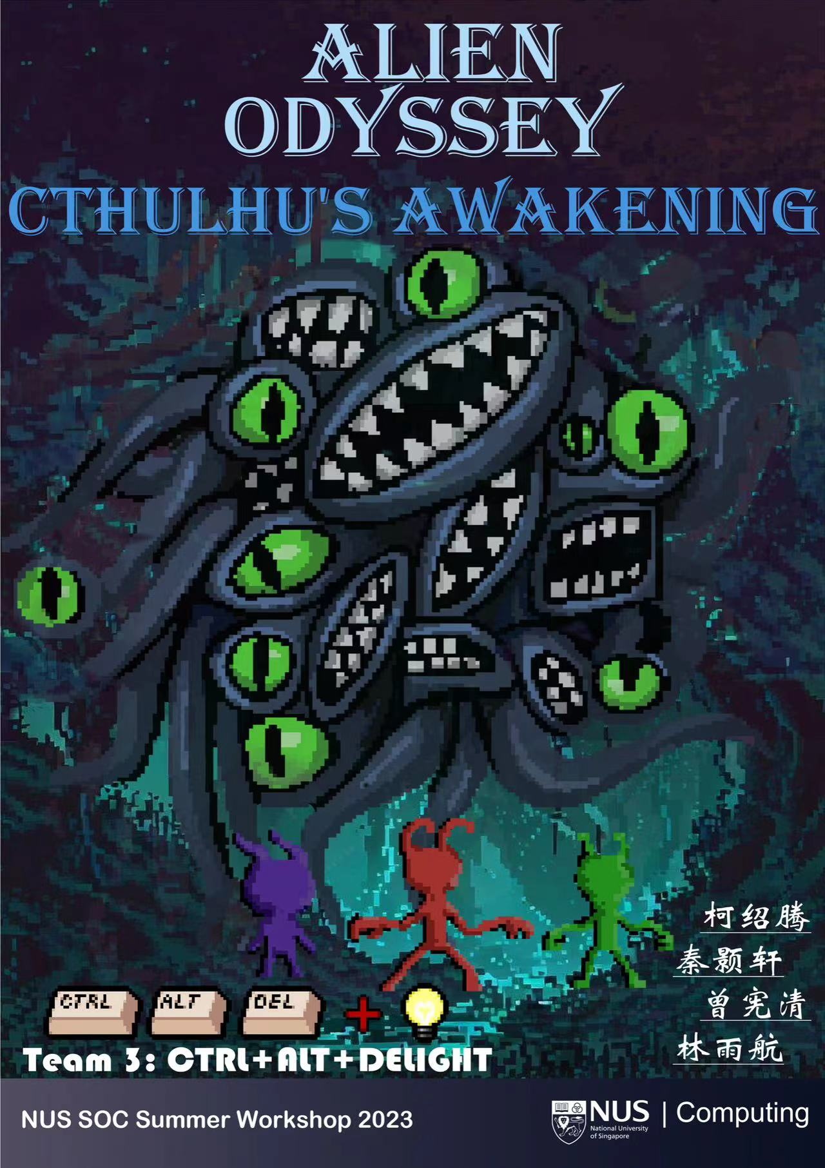
Alien Odyssey Cthulhu's Awakening
异星奧德賽：克蘇魯的覺醒
Final Version
柯绍腾、秦颢轩、曾宪清、林雨航
Team 3: CTRL+ALT+DELIGHT

Slide 2
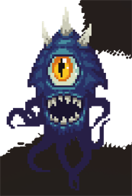
Final Boss AI
1. Summon 4 different types of minions at different health stages
在不同血量阶段召唤4种不同类型的小怪
2. Teleport at injured / random times
受伤/随机时刻瞬移

Slide 3
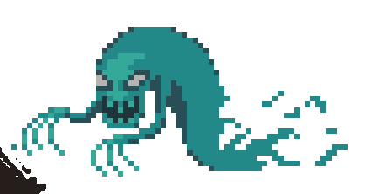
Shadow Monster AI
1. Cannot be attacked, appears at low SAN values and disappears at high SAN values.
不可被攻击，在低san值时出现，高san值时消失
2. Automatically tracks enemies and moves along the player’s historical trajectory.
自动追踪敌人，并沿玩家的历史行动轨迹移动

Slide 4
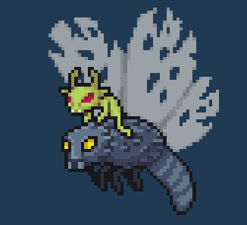
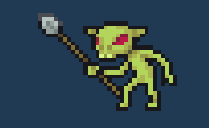
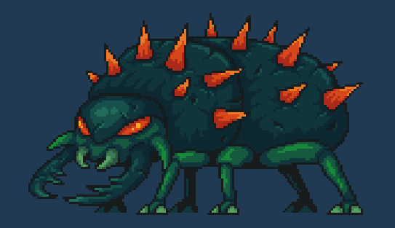
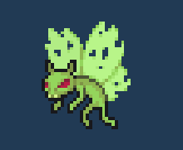
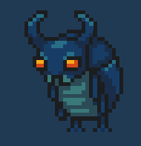
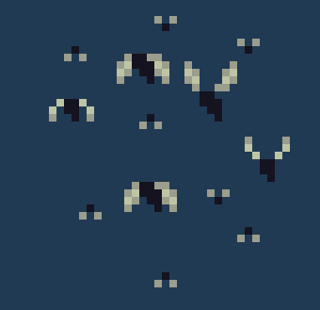
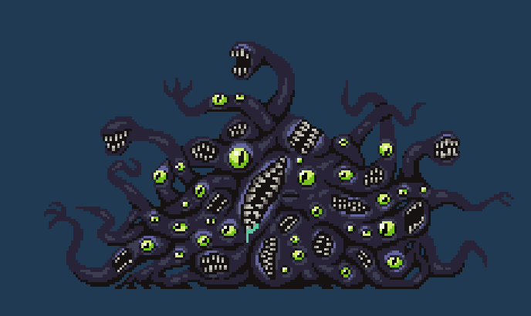
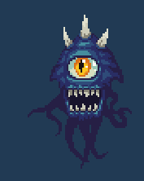
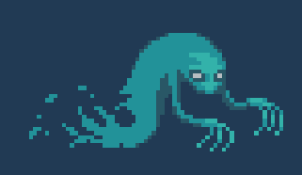
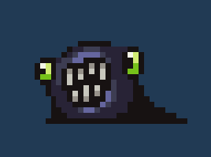
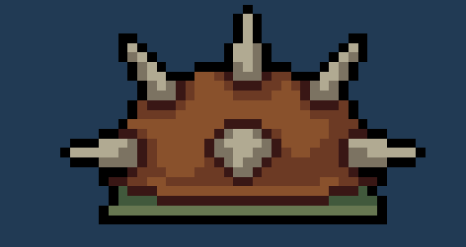
Overall Enemy AI
Design up to 13 types of enemies, including flying/walking/tracking, close-range/long-range/collision attacks and other types.
自行设计多达 13种 敌人，包含飞行/行走/追踪，
近程/远程/碰撞攻击等多种类型

Slide 5
What we have done:

Slide 6
Better & Larger MAP!
Tutorial
Level 1
BOSS 1

Slide 7
Better & Larger MAP!
Tutorial
New Tutorial
Level 1
Level 1
BOSS 1
BOSS 1

Slide 8
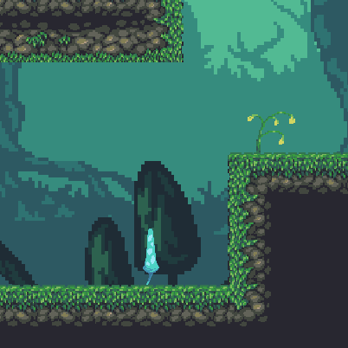
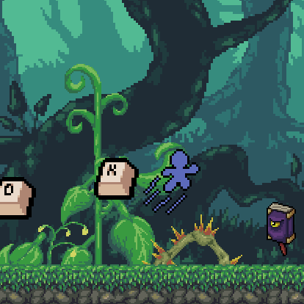
Better & Larger MAP!
Larger & Longer
Completely New Design!
Decorations!
Rare Plant

Slide 9
New MAP!
What’s this?
Level 2
BOSS 2

Slide 10
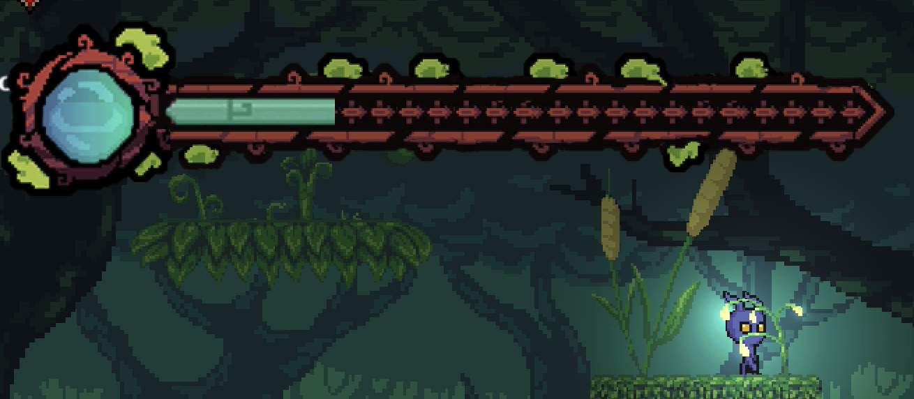
Totally Different Game (Cont.) :
1. Running & Chase Level (跑酷追逐关):
在幽暗且掉San的洞穴寻找出路，躲避影怪的追击
2. Puzzle Elements (解谜元素):
尝试解谜寻找解答谜题的方法

Slide 11
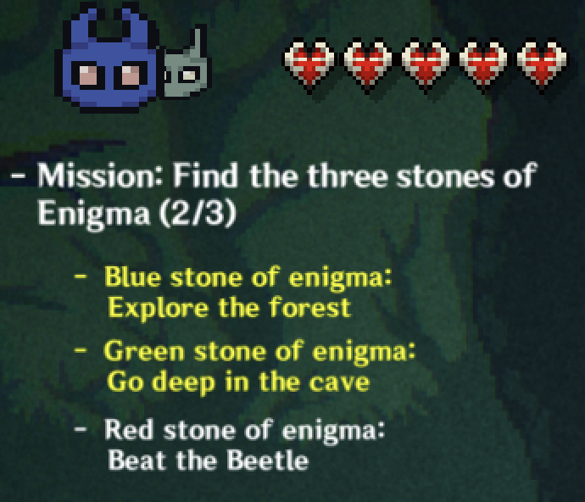
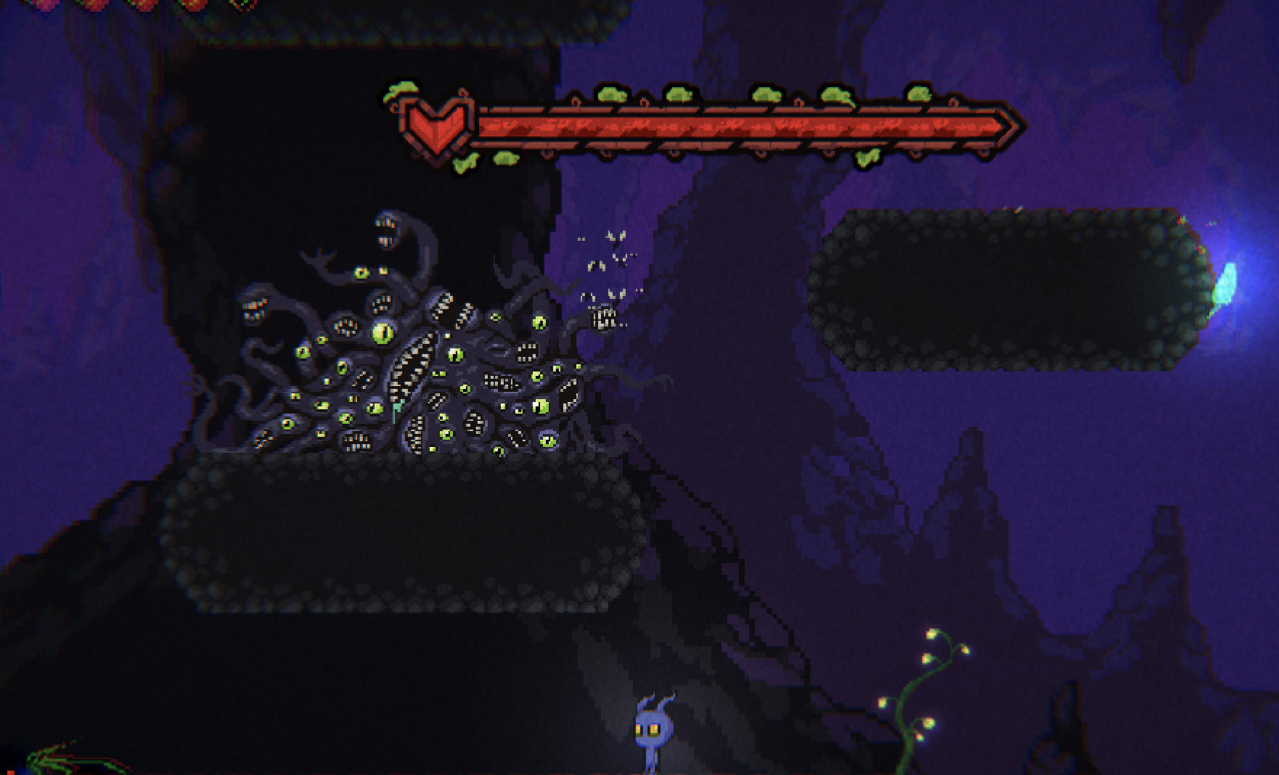
Totally Different Game:
3. Mission System for immersive game play (任务系统):
全新的任务系统以提供更明确的玩家引导
4. The Final BOSS -- Cthulhu (最终BOSS--克苏鲁):
召唤系最终BOSS克苏鲁
5. New BGMs

Slide 12
Totally Different Game (Cont.) :
5. The Final BOSS -- Cthulhu (最终BOSS--克苏鲁):
召唤系最终BOSS克苏鲁

Slide 13
What we improved based on your feedback:
1. Delete all old version scenes and skills, redesign them
(删除了之前所有关卡和繁琐的玩家技能并重新设计了更有探索欲的地形)
2. Enhanced the impact sensation (增加了敌人受伤，主角受伤的粒子特效和顿帧优化打击手感)
3. Refined and added more guidance (重做了低San影怪AI为协程: 模仿前一秒的主角移动)

Slide 14
and reality
Storyline in game

Slide 16
Control Instructions:
Jump: K
Only one skill for each character: U
Double Jump: K + K (for blue)
Dash: L (for green)
Heal Yourself: T (cheat code)
Change to secne1-3: Z X C V (cheat code)
Basic Movement: WASD
Character Switch: M
Attack: J + J + J + J...
Attack Down: S (held) + J
Attack Up: W (held) + J

Slide 17
On behalf of Team3, we extend our heartfelt appreciation to all of you. Thanks.

