Slide 1
Game Proposal
Represent by
team2 Red Hoodie
冯韵嘉 张天泓 马玥 欧曦

Slide 2
01
Background
02
Details
Objective, rules, characters, items
CONTETS
03
Sketches
04
Features
05
Challenges

Slide 3
PART ONE
Background

Slide 4
The story of growing up,
The story of redemption,
The story of making peace to yourself...
Game genre
Text here
Platformmer & Action
Supporting text here.
……

Slide 5
Plot
Little Red Hoodie woke up in a deep cave. The adventure began...
“I am failing..." The last thing that little red hoodie remembers is that although grandma kept warning her that bad things will happen if she leave the forest, the rebellious red hoodie insists to leave...
#Redemption
After crawling out ,she find herself in a forest…
She also remembered that the death of her grandma, she feeled so sad, puzzled, scared, and angry. But she has to keep going...
What exactly happened?
Little Red Hoodie must find back her lost memories in four different themes. After that, little red hoodie will finally meet her nightmare, she needs to overcome it, and then, maybe see her grandma again...
Little Red Hoodie will grow up.

Slide 6
PART TWO
Details

Slide 7
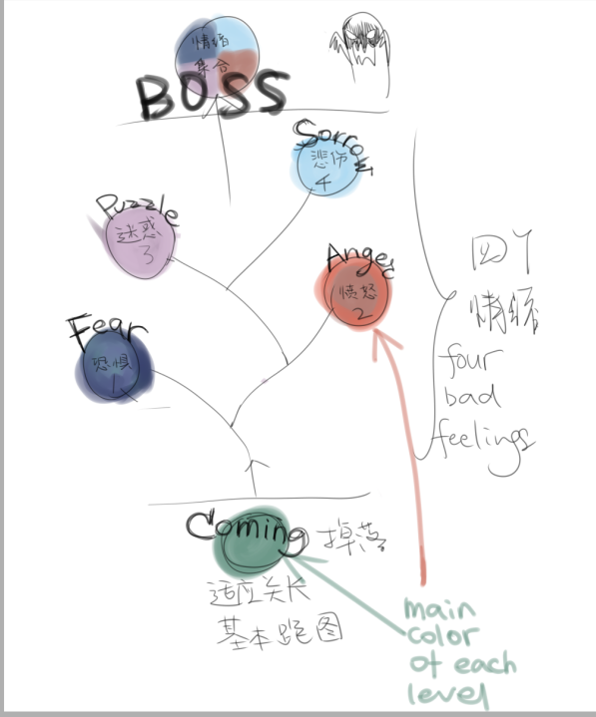
The overall game flow

Slide 8
objective
Details
Of
The
Game
Four small levels that symbolize different emotions and one ultimate level. Only when Little Red Hoodie passes all the levels can she retrieve her memories and complete the adventure.
rules
Each level has different themed maps, obstacles and enemies. Players need to operate Little Red Hoodie to successfully pass the level and get the key(item) to enter the next level; otherwise, the current level will be restarted.
characters
Little Red Hoodie : wants to find out the truth and retrieve her memories.
Grandmother: has passed away, and the strong love in soul recalls Little Red Hoodie to the forest.
???: other NPC...
items
Items that will unlock her memory, which are correlated to four moods and her grandma.

Slide 9
PART THREE
Sketches

Slide 10
UI
Collection
Menu(Help) Launguage
Health System
Mega System

Slide 11
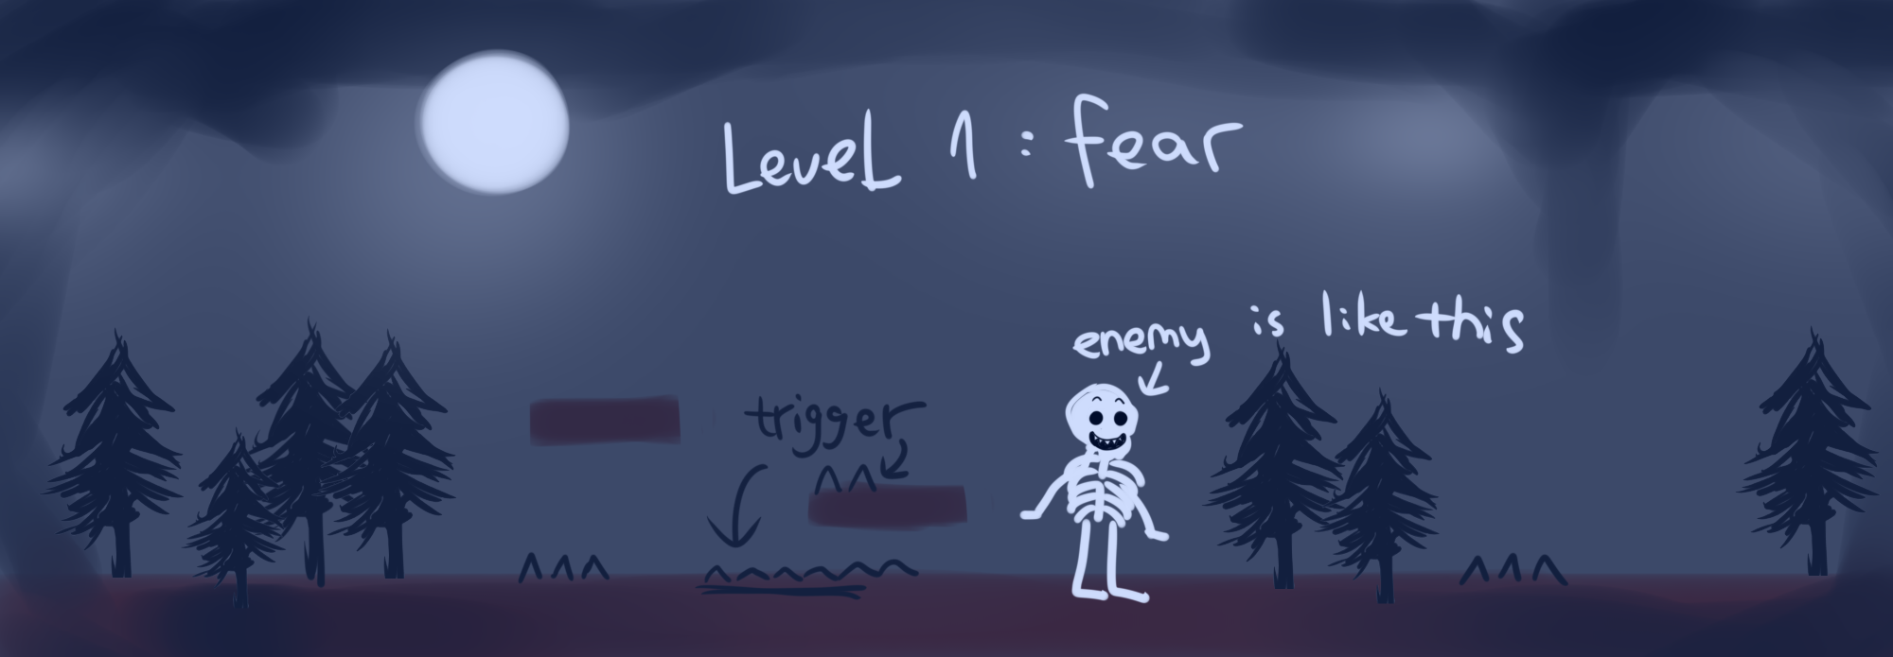
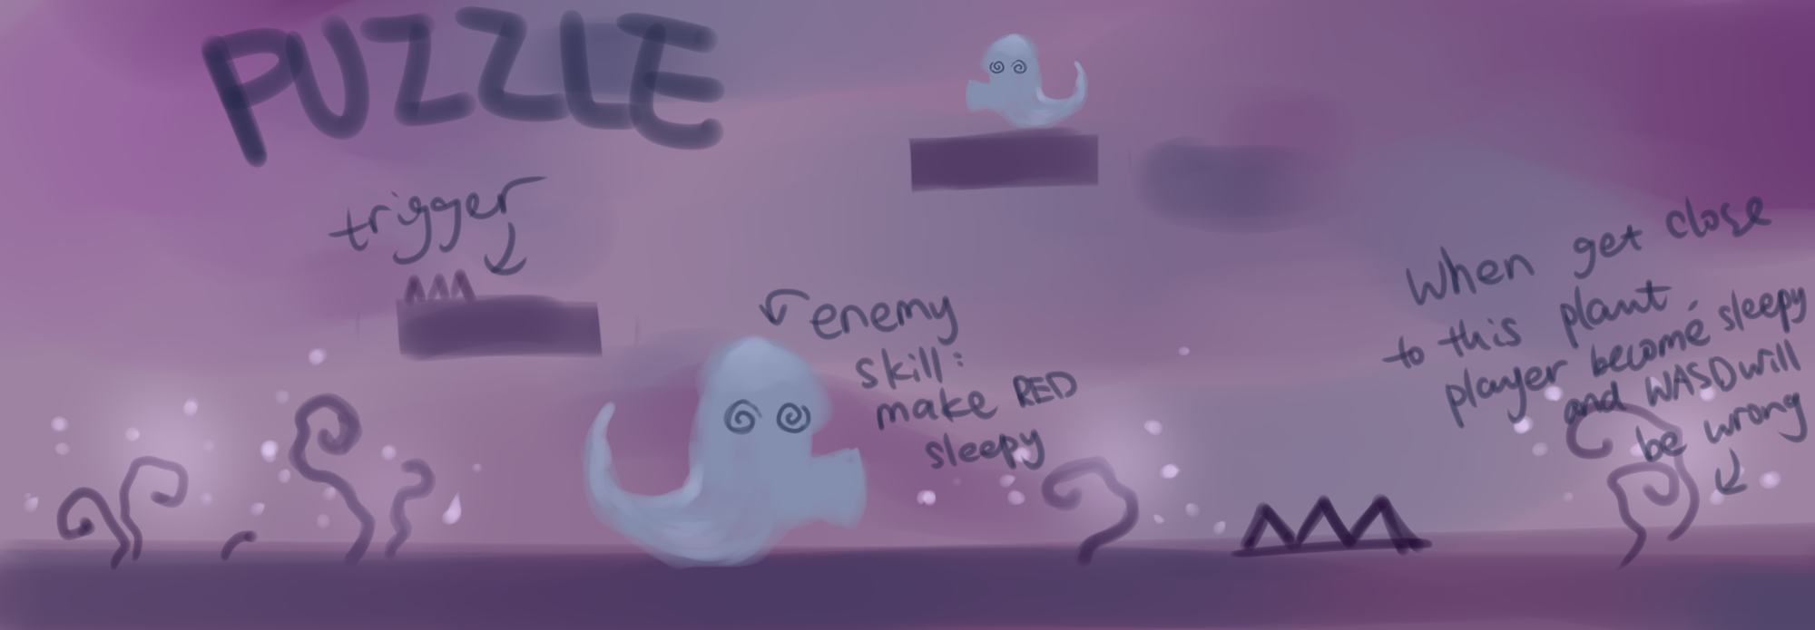
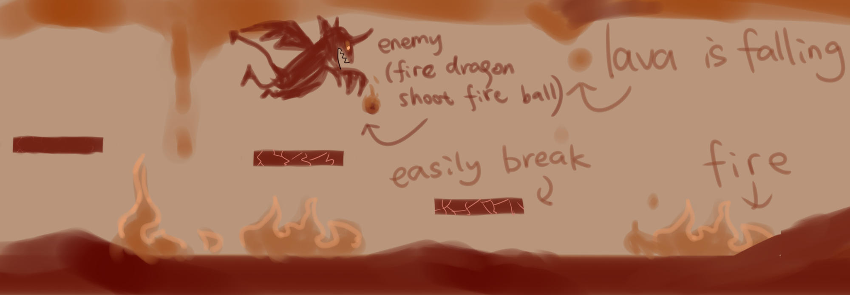
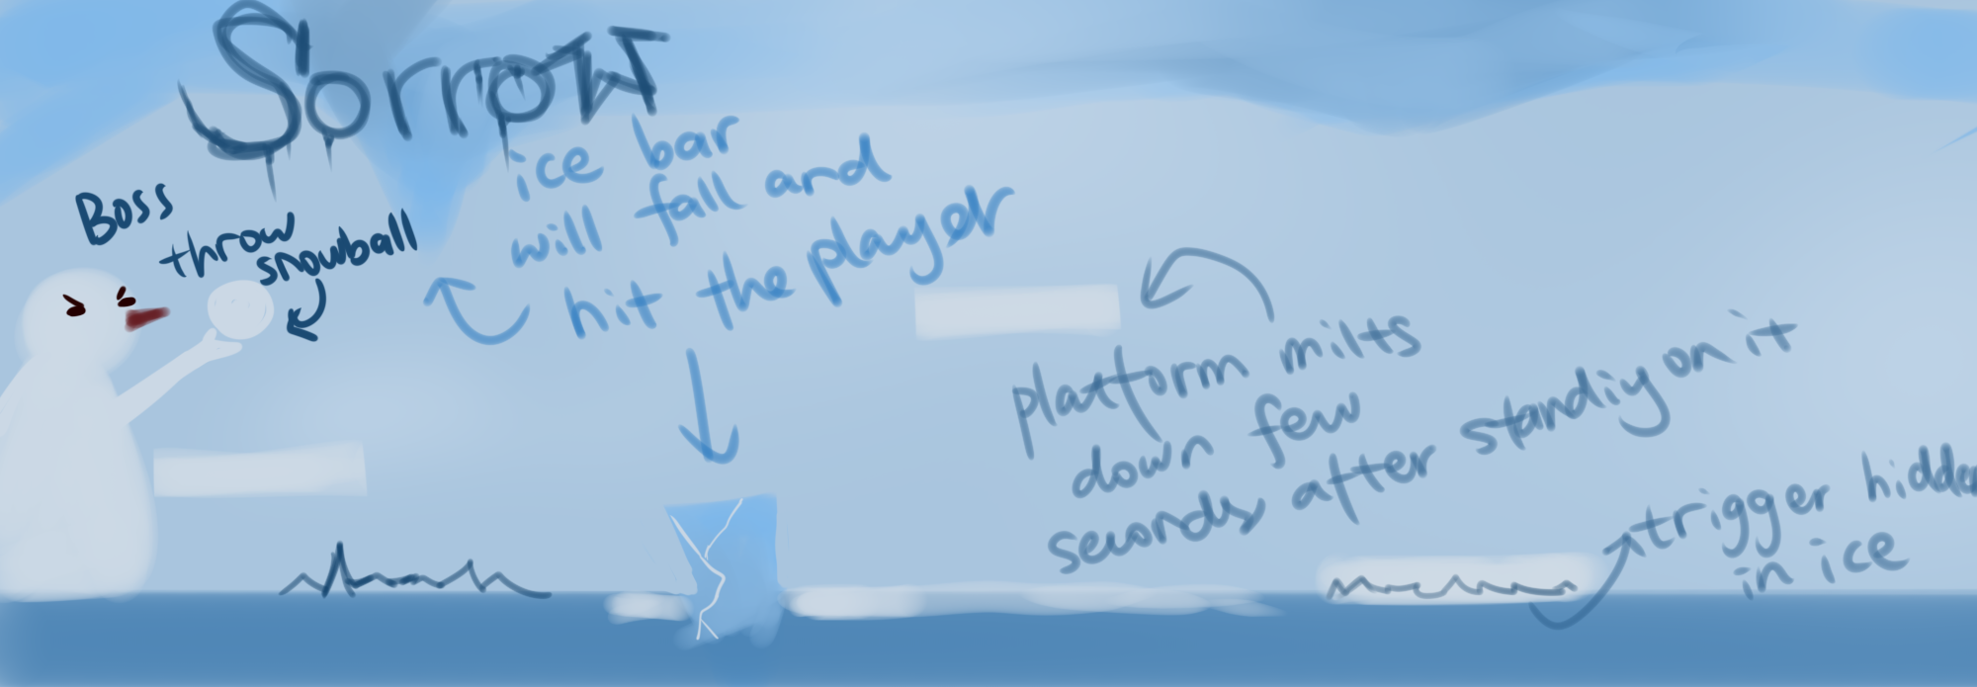
Game Level
Four colors represent four emotions and each level has its own color and Boss , as well as different playing methods
sketch

Slide 12
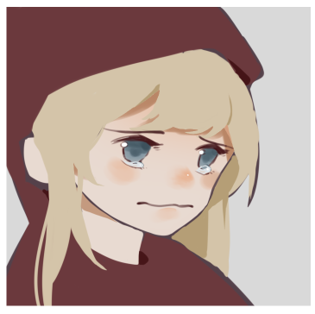
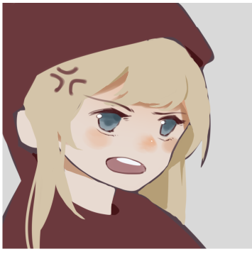
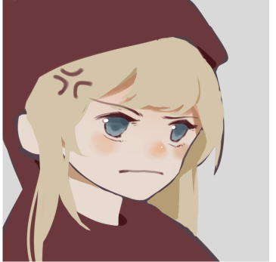
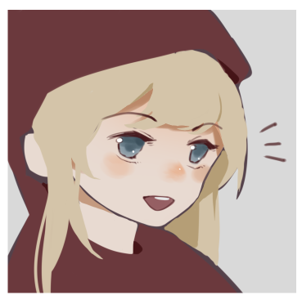
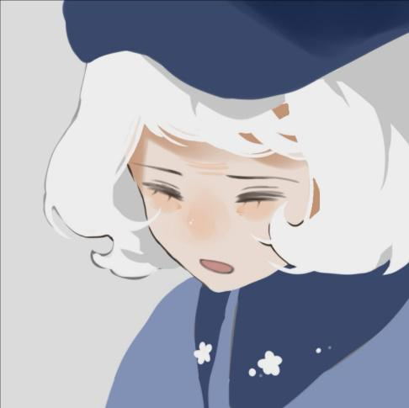
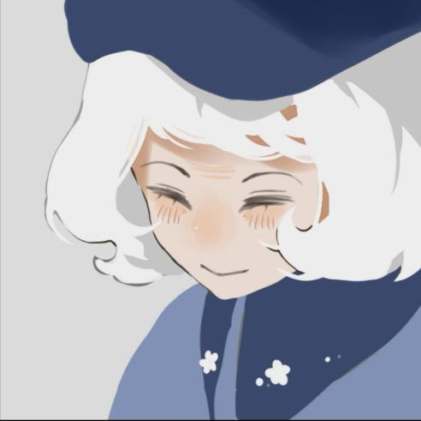
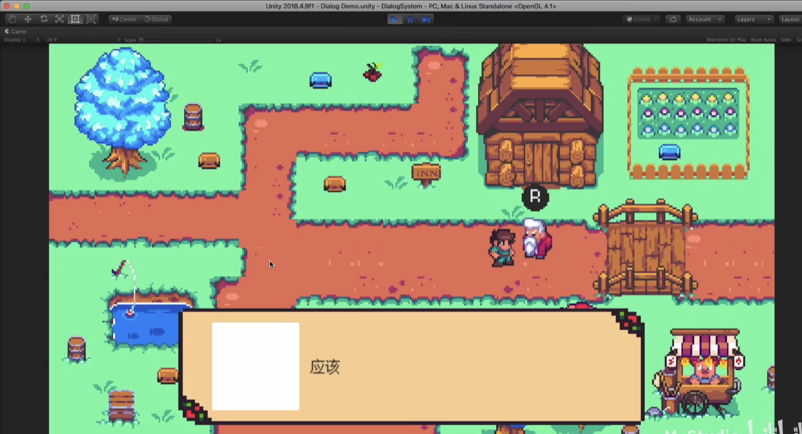
Plots in dialogs
Avatars of characters
Little Red Hoodie
Reference effect
Grandmother

Slide 13
PART FOUR
Features

Slide 14
1.Key frame
Frame 6 5 4 3 2 1
Time Frame
Key frame
Get Reward (Damage up)
Push Button at right moment!
Same for Defense...
Features

Slide 15
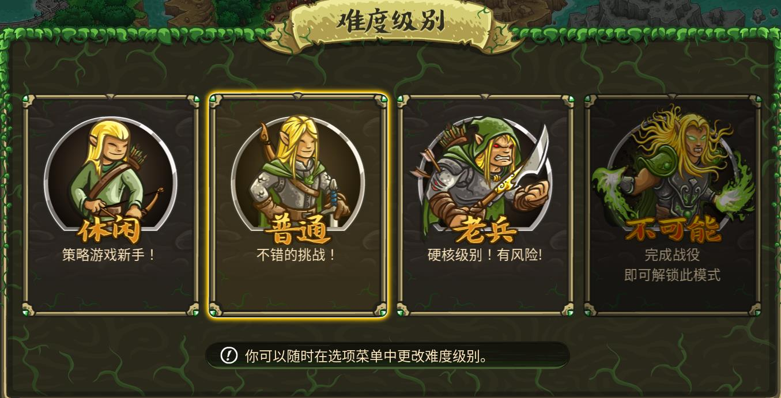
2.Repeat Value
Difficulty settings
Easter Eggs
Players could play multiple times for chanllenges
Players could find easter eggs hidden in the game!
Features

Slide 16
PART FIVE
Challenge

Slide 17
Challenges
Enemy AI
It is hard to design delicate enemy AI system
*Inspiring: FSM - Enemy patrol system + enmity system(enemy could be attracted if been attack)
Too Ambitious
Game mode: Complicated, Action & Platformmer
Levels: tutorial + 4 emotions(TBD) + Boss fight may cause a large working load
*How to solve? Working hard!

Slide 18
Game Proposal
THANKS!
Represent by
Red Hoodie
冯韵嘉 张天泓 马玥 欧曦

